Slide 1
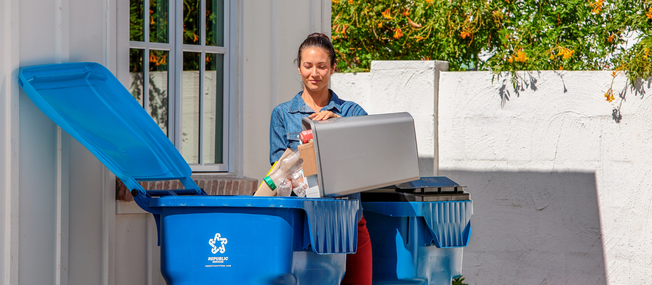

COVID-19 Municipal Update #1
March 20, 2020
Dan Higgins
Manager, Municipal Services

Slide 2
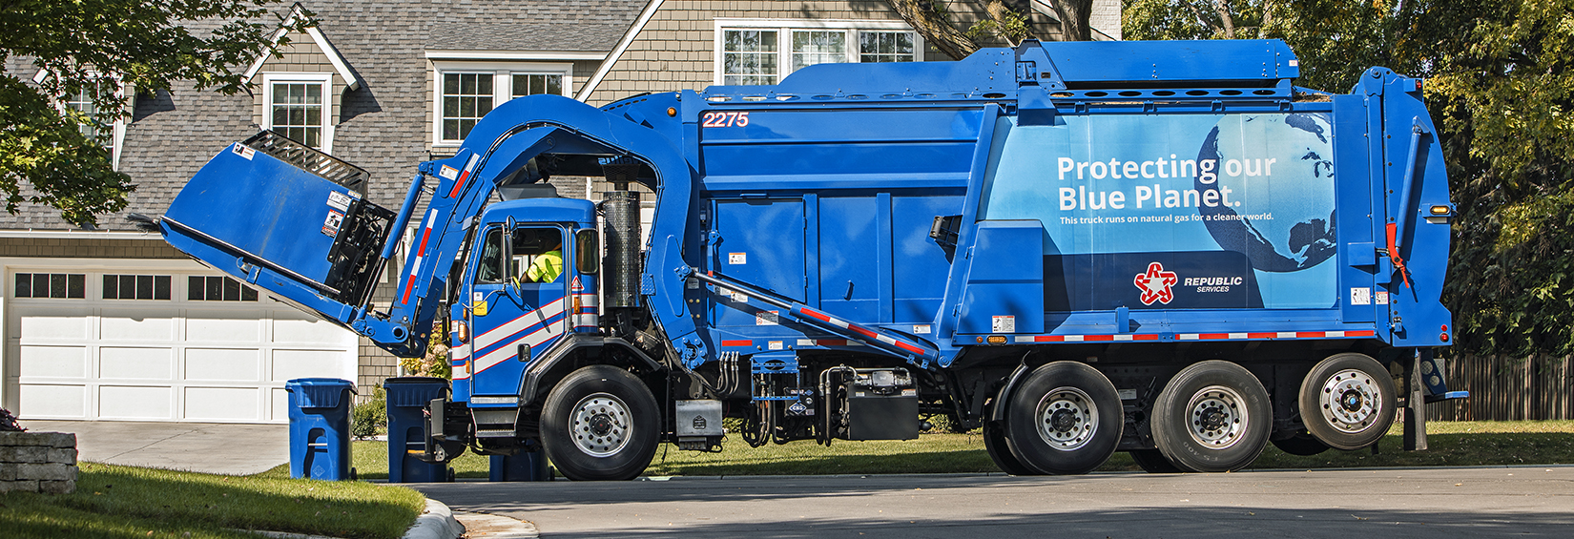
Our Commitment to You
Now more than ever, you can count on our Partnership.
We are working around the clock to ensure continuity of operations for your Municipality.
We are committed to operating this Essential Service for your community.
Business as usual is not an option, we must work together immediately to manage this unique set of evolving circumstances.
Our commitment to serving you through the “5-R’s” is unwavering.
Respectful. Responsible. Reliable. Resourceful. Relentless.
2

Slide 3


Business Continuity During the Pandemic
Business Continuity Overview
Republic Services has established plans for business continuity to respond to events that can cause a significant disruption to our operations.
Designed to protect lives and property through effective use of existing resources.
Designed to continue business operations or to resume them as soon as possible, following a natural disaster, strike, pandemic or other disruptive event.
Pandemic Response Actions
Actively encouraging sick employees to stay home.
Providing all our employees with Paid Time Off (PTO).
Equipping our employees are with necessary Personal Protective Equipment (PPE).
A well-developed system to remedy any Driver shortages that might occur across our workforce.
Implemented redundancy measures at our three national Customer Resource Centers.
Deep cleaning disinfection plans in place for any of our operating locations that are impacted by the coronavirus.
Waste Collection During
the Pandemic
Federal health and safety agencies have determined that household and other municipal solid waste do not require special handling or separation. No additional disposal containers are necessary.
Continue to collect waste from households and businesses in accordance with our existing safety protocols.
Monitoring for new guidance from the CDC, OSHA, and other federal, state, and local authorities.
Our Crisis Response Teams are holding daily status and response discussions, from our Headquarters to your local Business Unit.
3

Slide 4
Challenges & Impacts

Slide 5
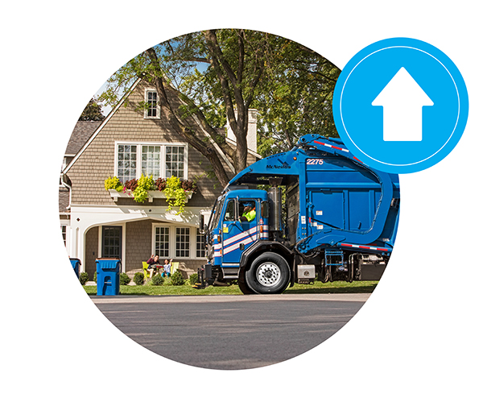
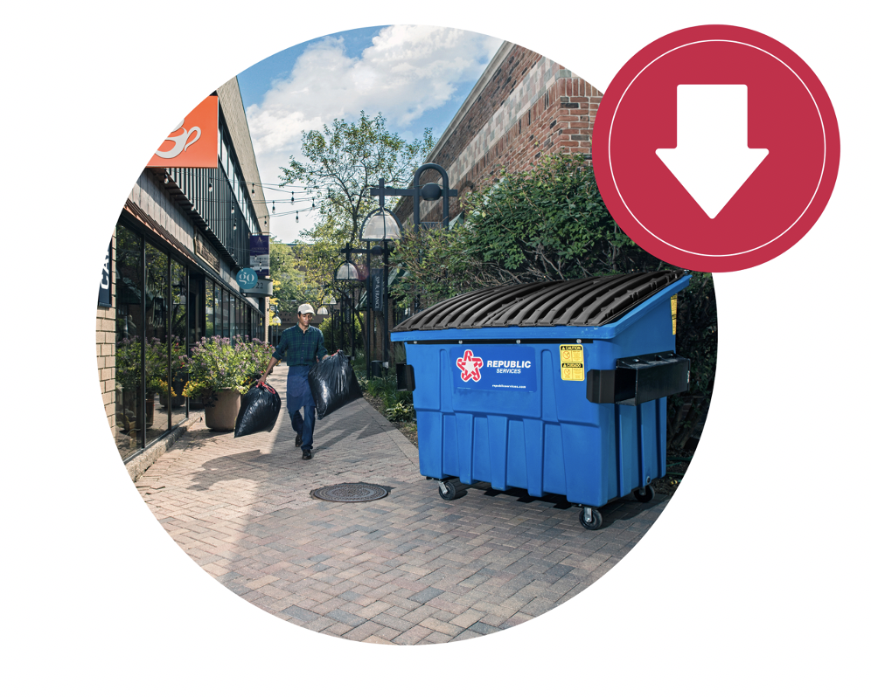
Shifting Volumes from Pandemic
Small and Large Container Volumes will decrease as businesses, bars, restaurants and schools close for a period of time.
Residential Volumes are expected to increase approximately 30%
Residents forced to remain home
More family with children home from college and school
Excess material obtained through panic purchasing
Residential volume increases will drive additional costs.
5

Slide 6

Impacts from Surge in Residential Volume
Residential routes will fill trucks faster, requiring more trips to the disposal site.
Additional Hours, Drivers and Trucks will be required to serve the routes on time.
30% Higher Tonnage and Disposal Costs projected due to additional waste collected from Residential customers.
We are actively adjusting staffing, equipment and operations to meet your waste and disposal needs during this crisis.
6

Slide 7
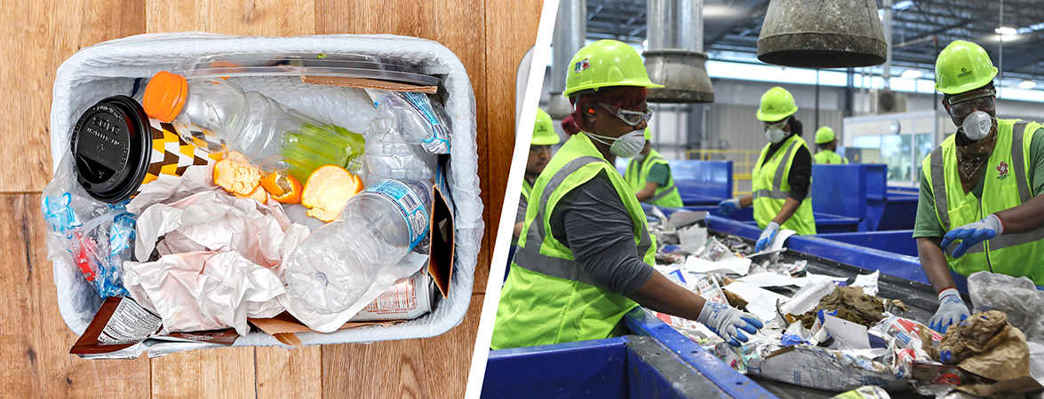
Recycling Challenges from Pandemic
Recycling Contamination will Increase as excess waste material from the homeowners finds its way into the Recycling container.
Recycle Processing Operations at Risk as 3rd party processors stop operations.
The pandemic will drive uncontrollable challenges in recycling.
7

Slide 8
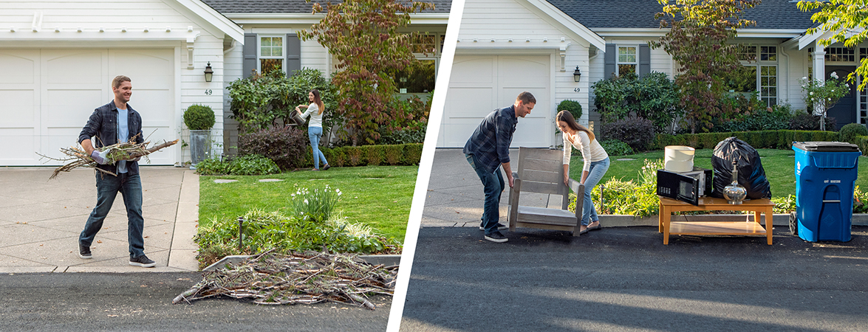
Yard Waste and Bulk Challenges
Yard Waste and Bulk Collection routes pull key resources and assets away from residential routes that need extra support.
Yard Waste and Bulk Routes are not essential during the pandemic. We need those resources to focus on MSW collection.
8

Slide 9


We Need Your Help and Your Partnership
Topic
Impacts
Economic Cost
Residential MSW Volume Surge
30% more Tonnage and Disposal
Extra Labor and Trucks
Route Efficiency Impacts
Estimated cost increase of $2.15 per home per month
Recycling Processing Impacts
Increased Contamination
3rd Party Processors stopping operations
Increased disposal costs and supply disruption
Cost Offsets:
Cart Contents Only for MSW
Suspend Yard Waste services
Suspend Bulk Waste Collection
Approval to dispose of recyclables due to contamination or disruptions in processing capabilities
We remain committed to you throughout this crisis, and are working hard to keep your community safe and free of waste.
9

Slide 10
Next Steps
Approval of request initially through letter contract to allow expedited service
Town Council Approval at next possible meeting
Communication to Community of guidance and recommendations for set-out of extra material
Monitor and reporting through end of the pandemic
We are here for you during these hard times.
Together, we will prevail against this situation.
10

Slide 11

Dan Higgins
Manager, Municipal Services
e: dhiggins@republicservices.com
o: 978-226-9414 c: 508-726-7270

