Slide 1

2022 Annual Town Meeting
Presentation of Warrant by Town Administrator Lisa Wong
April 27, 2022
6pm Virtually

Slide 2
Annual Town Meeting schedule for May 11, 2022 at 6pm
Some “new” Town Meeting Members, who will be sworn in as the first act of the Moderator at the commencement of the meeting.
The Annual Town Meeting will be held in-person at the South Hadley High School, 153 Newton Street, beginning at 6 PM. There is a mask advisory in place.
The Town Meeting Members will be asked by a motion from the Moderator to allow under section 8 Chapter 92 of the Acts of 2020 (State of Emergency Order from Governor Baker) to utilize handheld tabulators for voting at this Town Meeting.
When you arrive at the event you will receive a set of the green and red paddles which were used in the previous drive-in town meeting. Vote no (red) or green (yes) and the paddles will be used for the initial vote and for all votes, if the motion fails to use the tabulators.
You will be asked to return the paddles and the tabulators as you leave the meeting. Each tabulator will be individually assigned to a member.

Slide 3
WARRANT ARTICLES 1-6: CONSENT AGENDA
Warrant articles one through six will be presented as a Consent Calendar on a motion from the Selectboard Chair and a second by the Vice Chair of the Selectboard.
These six articles are a required of each town to be accepted every year as a matter of state law.
The acceptance allows the Town to borrow money is emergency situations with the approval of the Selectboard and the Treasurer with other limitations prescribed by MGL Chapter 44 subsection 17.
The other five, allow the municipality to set up bank accounts, allow the Selectboard to hire counsel to defend the Town against any lawsuits, to accept grants, including Chapter 90 and to set the compensation as budgeted for elected officials.

Slide 4
WARRANT ARTICLE 7-8: REVOLVING ACCOUNTS
Article 7: This is an annual required acceptance of this 53E1/2 revolving account for the purpose of accepting donations or other non-taxable revenues for the purpose of improving Buttery Brook Park. It sets a spending limit of $20,000. The present balance is $6,366 dollars as of April 26, 2022
Article 8: This is a new revolving account that is being requested to cover expenditures for the new Woodlawn Cafe at the Senior Center. There will be a spending limit of $30,000 set.

Slide 5
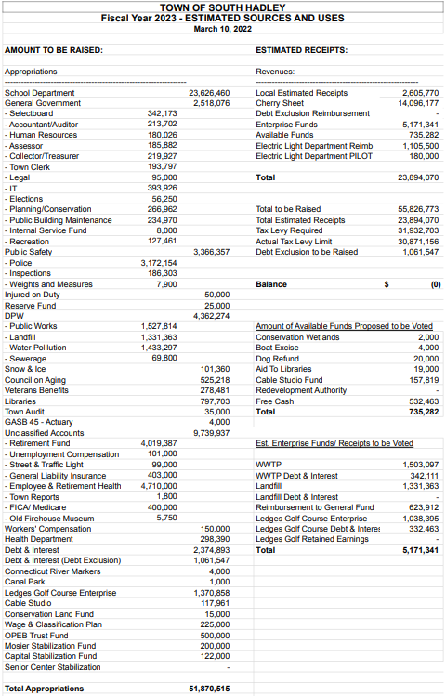
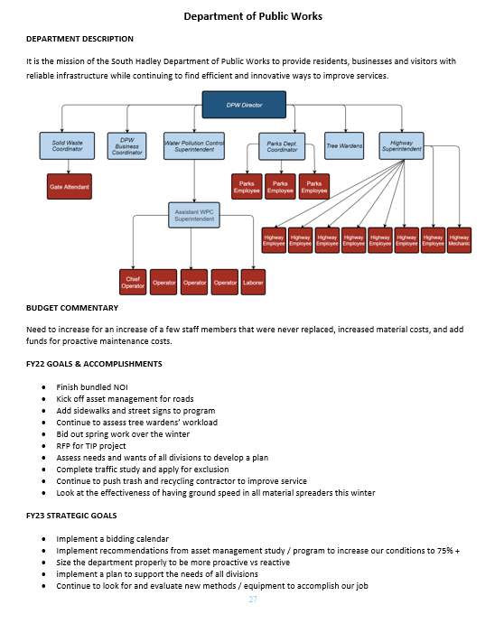
Article 9: Budget https://southhadley.org/679/Budget-Town-Meeting-Documents
$51,870,515 is the amount to be approved at Town Meeting to provide services to the community.
$5,171,341 is from Enterprise Funds (paid by ratepayers).
The budget with departmental expenditures, meeting links and other important information can be found on the website “Budget and Financial Information “ page.
The final budget book will also have departmental details such as accomplishments and goals.

Slide 6
WARRANT ARTICLE 9: FISCAL YEAR 2023 OPERATING BUDGET
preventive maintenance for Town buildings and public works
mental health resources - grant for mental health clinicians
free transportation for seniors - started April 1 for residents 60+
sustainability - LED lights, hybrid vehicles
conservation efforts - funding for projects in budget and capital
accessibility - funding for ADA improvements
public health - grant for initiatives
training and staff development - public safety and human resources
stabilization funds - capital and Mosier School
data management - upgrades in software and communication systems
town clerk - state election and restoring assistant town clerk position

Slide 7
WARRANT ARTICLE 9: FISCAL YEAR 2023 OPERATING BUDGET
Proposed Operating Budget - Increase of 2.4m from FY22 to FY23
Revenue: State Aid increase by over $1m; Tax Levy increase by $1m; 125k increase in local receipts; 185k increase in use of Enterprise funds
Expenses:
Increase School Budget by $1.15m
Add $122,000 to Capital Stabilization Fund
Add $200,000 to the Mosier School Stabilization Fund
$500,000 increase in costs for retirement, health insurance
$200,000 increase to General Government (add Assistant Town Clerk, funds for Boards and Commissions, Conservation efforts)
$140,000 increase to public works to restore parks, highway
$90,000 increase in public safety, training
Add $112k to Ledges Golf Course - revenue also increasing

Slide 8
WARRANT ARTICLE 10-13: CAPITAL EXPENDITURES
Capital Expenditures were voted on by the Capital Planning Committee
Article 10 projects will be funded from $1,600,500 in Free Cash ($1,452,594 remaining after Town Meeting votes) and $65,000 from the Cable Access Fund ($177,946 remaining after Town Meeting votes)
Article 11 projects will be funded from $515,000 in Wastewater Treatment Plant Retained earnings ($544,829 remaining after Town Meeting votes)
Article 12 and 13 project will be funded from $125,600 in Ledges Retained earning ($89,553 remaining after Town Meeting votes)

Slide 9
WARRANT ARTICLE 10: FISCAL YEAR 2023 CAPITAL
Article 10: From Free Cash and Cable Access Funds
$676,000 for High School Drainage and HVAC;
Police: $90,000 for Roof; $132,000 for HVAC; $124,000 for Vehicles; $14,000 for LED lights; $10,000 for office equipment;
$10,000 for Buttery Brook Maintenance;
$65,000 for Queensville Dam Removal;
$68,500 for DPW Plow; $6,000 for Parks Sander; $6,500 for DPW Trailer; $80,000 for DPW skid steer
$100,000 for Document Preservation and Digital Data System;
$105,000 for Parks Barn Siding and Roof;
$85,000 for Council on Aging Van;
$20,000 for Library Accessibility;
$9,500 for Conservation Area Improvements;
$65,000 for Cable Studio Renovations

Slide 10
WARRANT ARTICLE 11-13: FISCAL YEAR 2023 CAPITAL
Article 11: Funded from Wastewater Enterprise Retained Earnings
$400,000 for the Main Street Generator;
$35,000 for the Channel Grinder;
$40,000 for Wastewater Plant Security Gate;
$40,000 for Main Street Wastewater Pump Station Station Evaluation
Article 12: Funded from Ledges Retained Earnings
$113,600 for River Pump Replacement
Article 12: Funded from Ledges Retained Earnings
$12,000 for various repairs in FY2022

Slide 11
WARRANT ARTICLE 14: CAPITAL PLANNING COMMITTEE
Purpose: To change the lower cost limit with respect to proposed capital projects and improvements that the Capital Planning Committee reviews:
Current language: Cost over $10,000.
Proposed language: Cost over $25,000

Slide 12
WARRANT ARTICLE 15-16: PLANNING BOARD
Article 15: Updated Master Plan - builds on the original 2010 Plan by redefining the vision for South Hadley’s next ten years, from 2020-2030, and identifying specific goals
The Planning Board held a public hearing on March 28
www.southhadley.org/1078/2020-Master-Plan-Update
Article 16: Stormwater Management Bylaw - replace the bylaw to be in compliance with the 2016 Massachusetts Small MS4 General Permit for the control of stormwater runoff and illicit connections and discharges from new and redevelopment projects
The Planning Board held a public hearing held on April 11
www.southhadley.org/DocumentCenter/View/8621/Article-PB-C---Stormwater-Management-Bylaw-Repeal-and-Replace---with-attachment

Slide 13
WARRANT ARTICLE 17: Human Rights Commission
Purpose:
1. Improving the life of the Town by enlisting community based groups in educational programs and campaigns to increase mutual respect, harmonious intergroup relations and the peaceful enjoyment of life in our community;
2. Working with Town Government, the School Department, Town Commissions and Boards to increase diversity, as well as awareness and sensitivity to human and civil rights issues;
3. Responding to complaints by persons in the Town who believe that their human or civil rights, as defined in this Bylaw or in state or federal law, have been violated in the Town;
4. Provide referals and information to persons with complaints which appear to the Commission to be the result of unlawful discrimination against any person(s) in the Town to any appropriate authority that has jurisdiction.
Members: 9 members who shall be residents of the Town for staggered 3 year terms. Two members shall be appointed by the Selectboard; two members shall be appointed by the Commission on Disability; two members shall be appointed by the School Committee; one member shall be appointed by the Council on Aging; one member shall be appointed by the Cultural Council; and one member shall be appointed by the Board of Health.
Notes:
Goal #1 of the Master Plan: South Hadley creates a respectful and welcoming environment in which all community members can prosper and thrive.

Slide 14
WARRANT ARTICLE 18: Mobile Food Vendor
Purpose: To allow and efficiently regulate the use of mobile food vending to expand food access in areas underserved by traditional restaurants, add interest, vibrancy, and activity to streetscapes, enhance business opportunities at brick-and-mortar establishments, and to ensure compliance with regulations regarding food safety, fire safety, motor and pedestrian safety, and nuisances such as noise, smoke, trash, and odors.
Encourage and provide guidance for food trucks, food trailers, and food cart to operate in the following areas:
Public Rights of Way
Private Commercial Properties
Vending/catering for events on private residential properties

Slide 15
THANK YOU!
Please send any questions you may have to LWong@southhadleyma.gov

